Slide 1
NeMo Guardrails Architecture

Slide 2

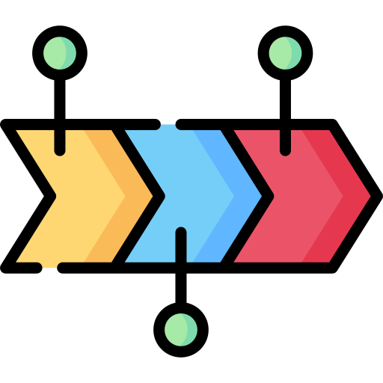

NeMo Guardrails Architecture
NeMo Guardrails architecture works with an event-driven design (i.e., an event loop that processes events and generates back other events) architecture. Based on specific events, there is a sequential procedure that needs to be completed before the final output is provided to the user. This process has three main stages:
Generate canonical user messages
Decide on next step(s) and execute them
Generate bot utterances

Slide 3
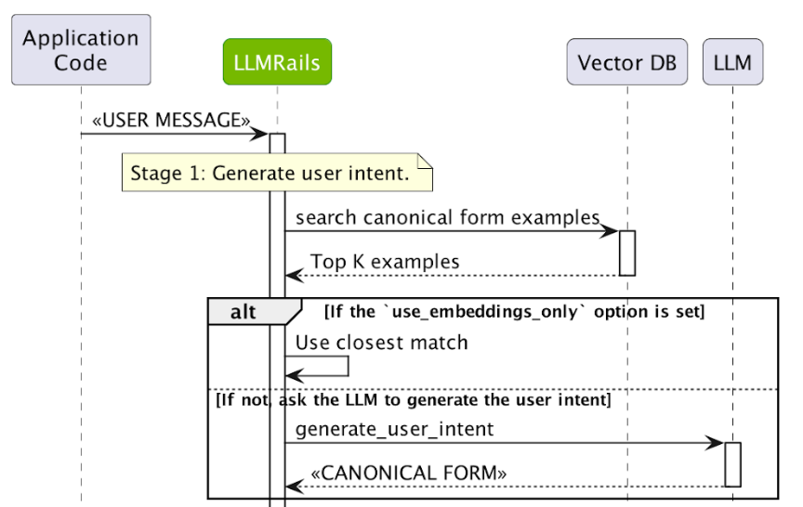
Stage 1: Generate canonical user messages
In the first stage, a canonical form is created regarding the user’s intent and allows the system to trigger any specific next steps.
The user intent action will do a vector search on all the canonical form examples in existing configuration, retrieve the top five examples and create a prompt that asks the LLM to create the canonical user intent.
Note: A Canonical form is a standardized representation of user inputs that maps different phrasings of the same intent to a single structured form for easier processing.

Slide 4
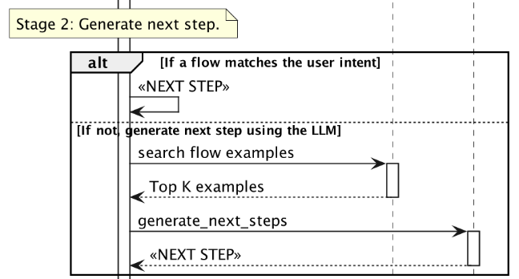
Stage 2: Decide on next step(s) and execute them
Once the intent event is created, depending on the canonical form, the LLM either goes through a pre-defined flow for the next step or another LLM is used to decide the next step.
When an LLM is used, another vector search is performed for the most relevant flows and again the top five flows are retrieved in order for the LLM to predict the next step.

Slide 5
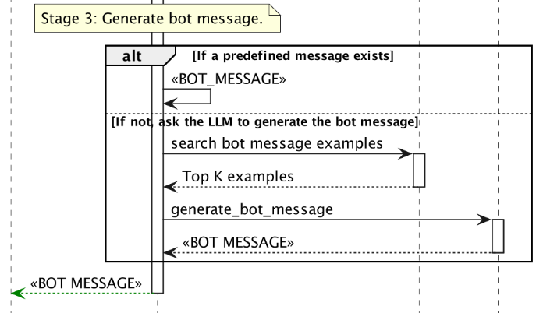
Stage 3: Generate bot utterances
Once the next step is determined, a bot_intent event is created so that the bot says something and then executes action with the start_action event.
The bot_intent event then invokes the final step to generate bot utterances.
Similar to previous stages, the generate_bot_message is triggered, and a vector search is performed to find the most relevant bot utterance examples.
At the end, a bot_said event is triggered and the final response is returned to the user.

Slide 6
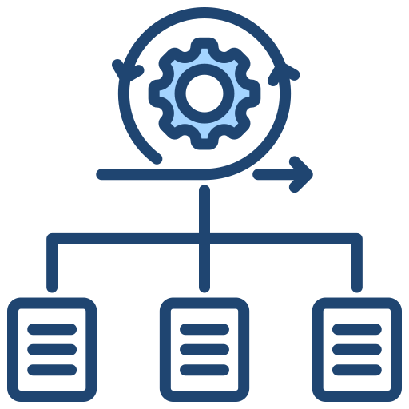
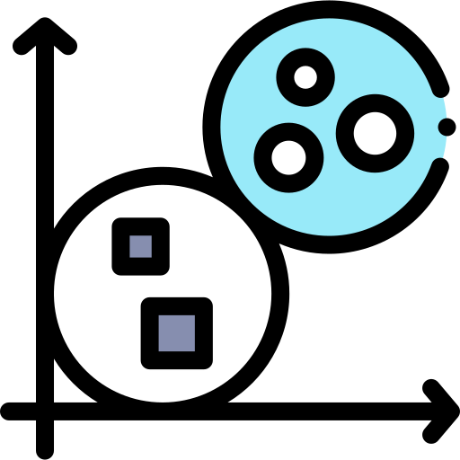
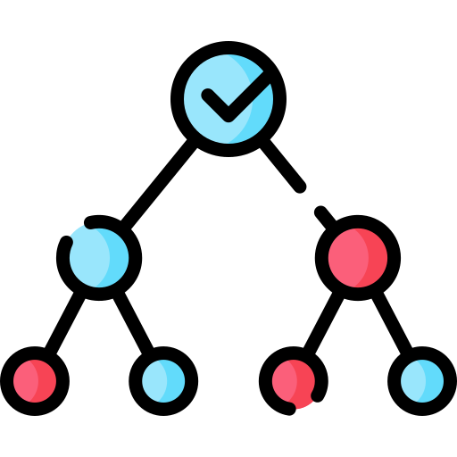
Events flow with Examples
Stage 1: Generate canonical user messages
Stage 2: Decide on next step(s) and execute them
Stage 3: Generate bot utterances
User says: "What's the weather like today?“
System converts it to: "get_weather" (standardized form)
Now that the system knows the intent, it moves to the next step!
Canonical form: "get_weather“
Next step: Either,
Use a pre-set rule: "Check weather API and respond with forecast."
Ask the LLM to decide: "Should I ask for the user's location first?“
Now that the system knows what to do, it moves to the final step!
Next step: "Tell the user today's weather“
Bot response: "The temperature today is 25°C with clear skies!“
And that’s it! The process repeats every time a user interacts with the bot.

Slide 7
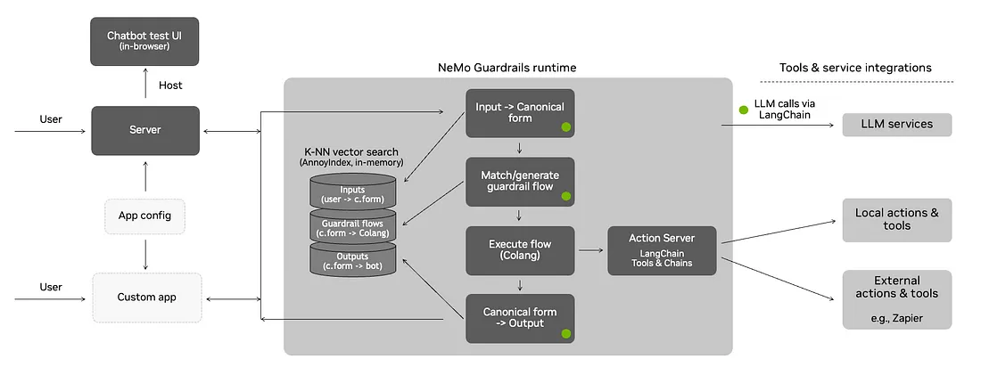
Nemo Guardrails Runtime
This image illustrates the layered approach to integrating guardrails and highlighting key points of the process of handling user input and generating responses in a chatbot environment, as well as, explaining how it integrates LLMs with external resources and provide insight into the framework’s design and how it facilitates the creation of chatbot functionalities.

Slide 8



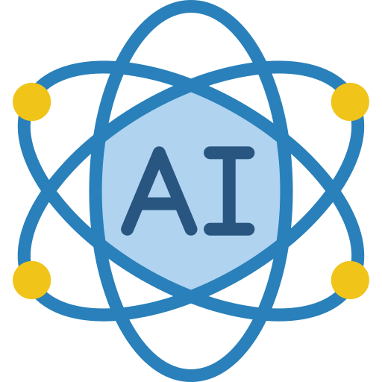
Workflow – Key Components Of Architecture
Chatbot Test UI
K-NN Vector Search
The user interacts with the chatbot through an in-browser interface, and the server processes the input based on the app configuration and customizations.
The system uses vector search to retrieve the most relevant examples or flows based on the user input and canonical form.
Input + Canonical Form
LLM Calls via LangChain
The canonical form is used to match or generate a guardrail flow, which is then executed using Colang and potentially involving local or external actions.
The system leverages LLMs via LangChain for generating responses and performing complex tasks, integrating with local and external tools as needed.

Slide 9
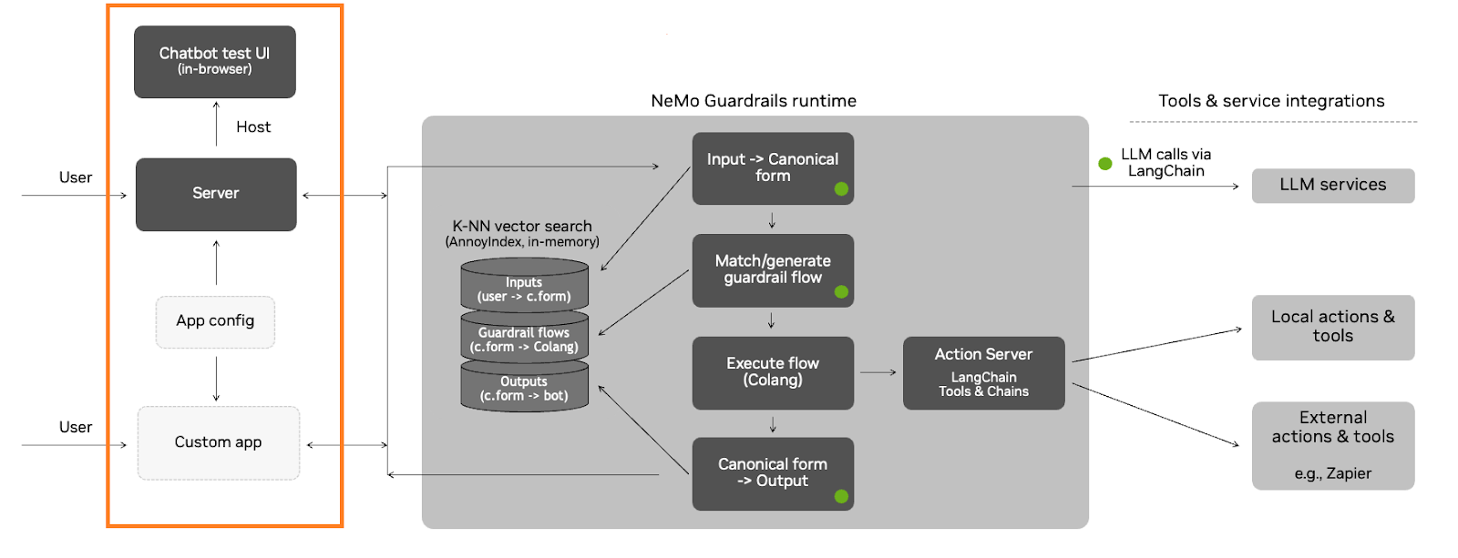
Chatbot Test UI (In-Browser)
Purpose: Provides an interface for users to interact with the chatbot and for developers to test the system.

Slide 10

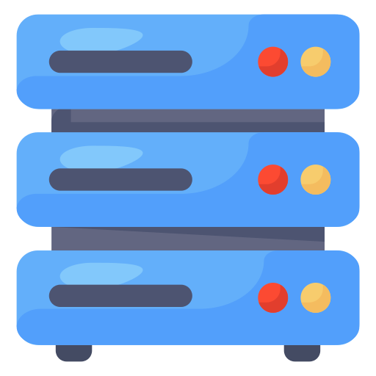
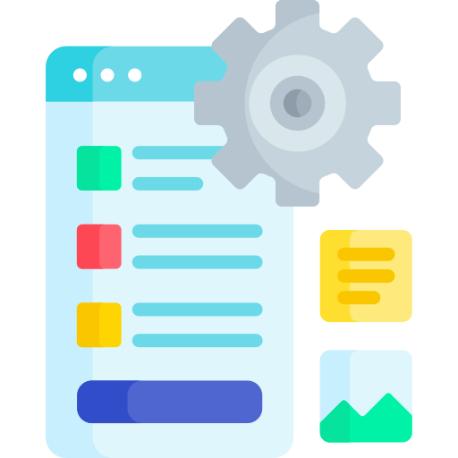
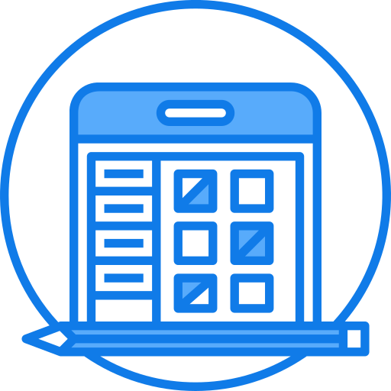
Chatbot Test UI (In-Browser)
Components:
User
Server
App Config
Custom App
The end-user who interacts with the chatbot by sending messages and receiving responses.
The backend system that processes user inputs, manages the conversation flow, and generates responses.
Configuration settings that define the behaviour , guardrails, and capabilities of the chatbot.
Customizations or extensions to the chatbot, such as additional features, integrations, or tailored responses.
Workflow: The user interacts with the chatbot through the in-browser UI, and the server processes the input based on the app configuration and any customizations.

Slide 11
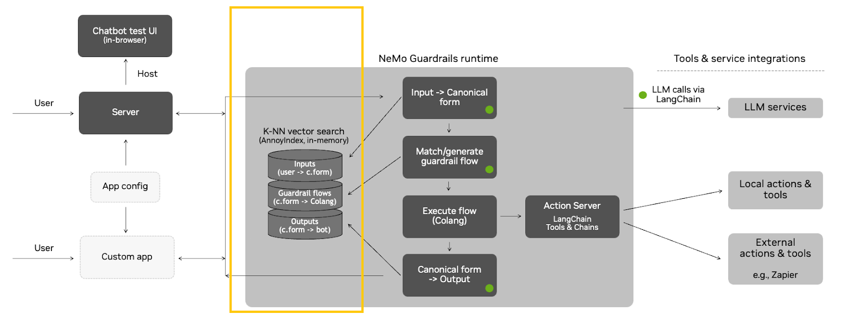
K-NN Vector Search (Annoy Index, In-Memory)
Purpose: Efficiently retrieves the most relevant examples or flows based on user input and canonical forms.

Slide 12
K-NN Vector Search (Annoy Index, In-Memory)
Components:
Inputs (user + c.form):
Guardrail flows (c.form + Colang)
Outputs (c.form + bot)
The canonical form and Colang (a domain-specific language for defining guardrail flows) are used to retrieve relevant guardrail flows.
The canonical form and the bot’s response are generated as outputs after processing.
The raw user input and its canonical form (standardized representation of intent) are used as inputs for the vector search.
Workflow: The system uses K-Nearest Neighbors (K-NN) with an Annoy Index (an efficient in-memory search library) to perform vector searches. This helps in quickly finding the most relevant examples or flows based on the input and canonical form.

Slide 13
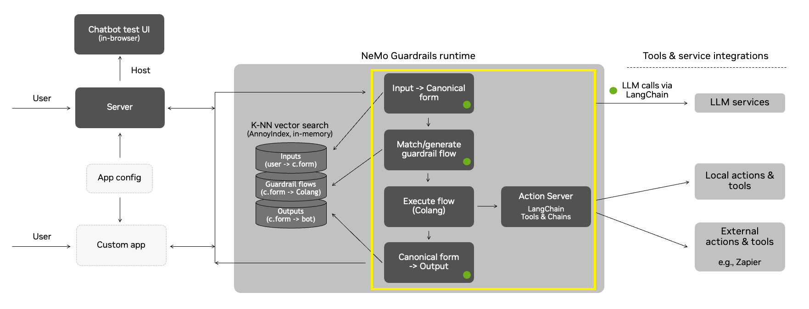
Input + Canonical Form
Purpose: Processes the user input and canonical form to determine the appropriate guardrail flow and execute it.

Slide 14
Input + Canonical Form
Components:
Match/generate guardrail flow
Execute flow (Colang)
Action Server LangChain Tools & Chains
Canonical form + Output
The system matches the canonical form to an existing guardrail flow or generates a new one if necessary.
The selected guardrail flow is executed using Colang, which defines the rules and logic for the conversation
The flow execution may involve calling LangChain tools and chains for local actions, such as retrieving information or performing calculations.
The final canonical form and bot response are prepared for delivery to the user.
Workflow: The user input is transformed into a canonical form, which is used to match or generate a guardrail flow. The flow is then executed, potentially involving local or external actions, to determine the next steps in the conversation.

Slide 15
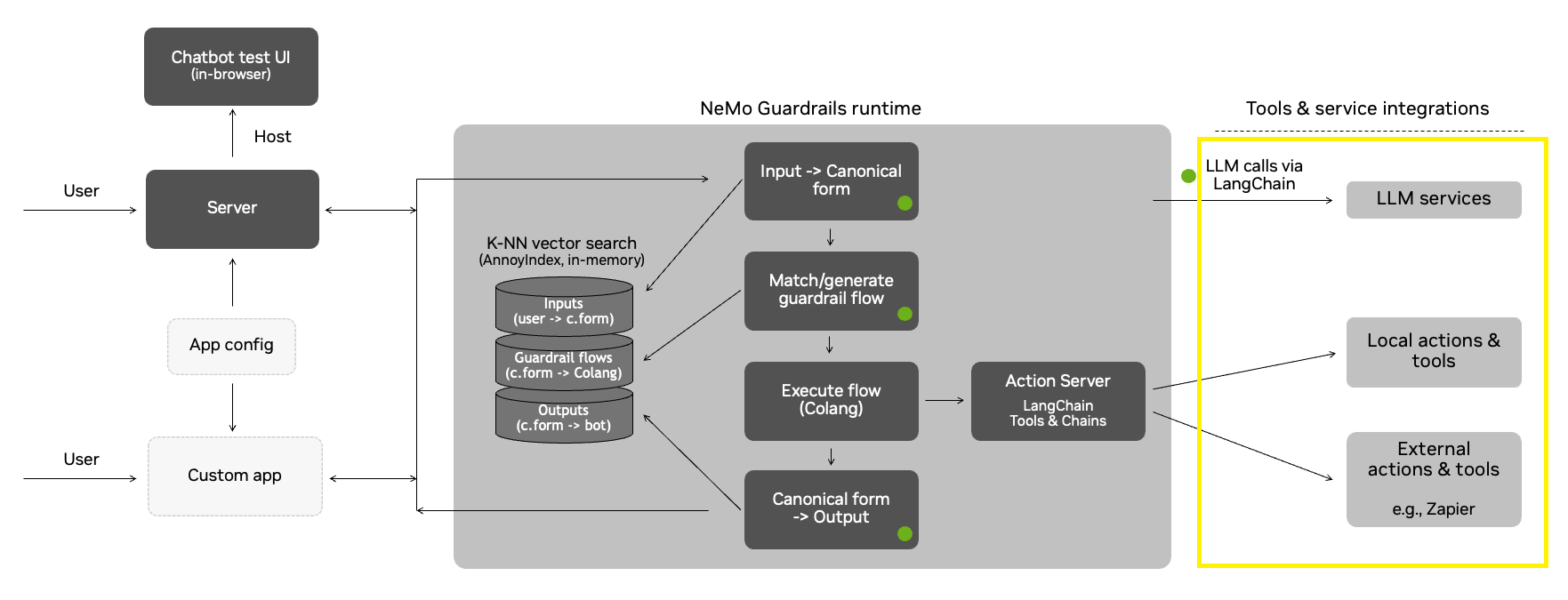
LLM Calls via LangChain
Purpose: Leverages Large Language Models (LLMs) for generating responses and performing complex tasks.

Slide 16
LLM Calls via LangChain
Components:
Local action & tools
External actions & tools (e.g., Zapier)
The system can call local actions and tools via LangChain, such as retrieving data from a local database or performing specific computations
The system can also integrate with external tools and services, such as Zapier, to automate workflows or interact with third-party APIs.
Workflow: When the system needs to generate a response or perform a complex task, it makes calls to an LLM via LangChain. This allows the chatbot to leverage the LLM’s capabilities for natural language understanding, generation, and task execution, while also integrating with local and external tools for additional functionality.

Slide 17
Designing Guardrails for Specific Use Cases
To ensure the effectiveness, security, and ethical integrity of a chatbot, it is essential to establish well-defined guardrails. Below are the key principles to follow:
Define Acceptable and Unacceptable Behavior Clearly outline the chatbot’s intended functionality and limitations.
Ensure responses align with its purpose.
Example: A customer service chatbot should provide informative and professional responses while avoiding personal opinions or speculative statements.
Implement Content Moderation Utilize keyword filtering to block offensive, harmful, or inappropriate language.
Deploy Natural Language Processing (NLP) models to detect and mitigate biased, discriminatory, or misleading content.
Ensure Factual Accuracy Integrate responses with verified and trusted data sources.
Maintain and regularly update knowledge bases to prevent the dissemination of outdated or incorrect information.

Slide 18
Contd.
Maintain a Professional and Consistent Tone Leverage predefined response templates to ensure uniformity in communication.
Implement sentiment analysis to adjust tone dynamically, ensuring user-friendly and professional interactions.
Prevent Scope Creep Restrict responses to the chatbot’s defined domain of expertise.
Use intent recognition to avoid engaging with unrelated or sensitive queries.
Ensure Factual Accuracy Integrate responses with verified and trusted data sources.
Maintain and regularly update knowledge bases to prevent the dissemination of outdated or incorrect information.

Slide 19
Integrating Guardrails into Existing AI Pipelines
Integrating guardrails (e.g., Nemo Guardrails) into an existing Large Language Model (LLM) chatbot involves adding a layer of safety, moderation, or compliance checks to ensure the chatbot behaves as expected and avoids harmful or inappropriate outputs.

Slide 20

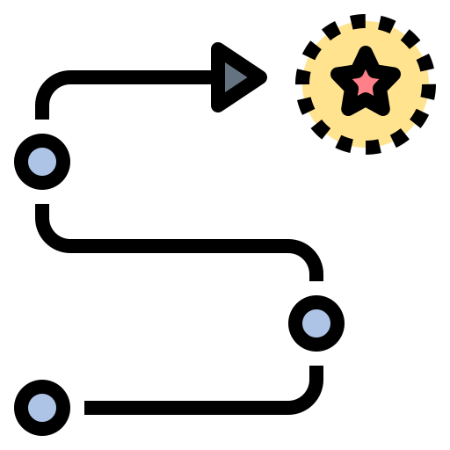

Step-by-Step guide to integrating guardrails into your LLM chatbot
Define Guardrail Requirements
Choose the Integration Architecture
Implement Guardrail Logic
Purpose: Clearly define what the guardrails are meant to achieve (e.g., content moderation, safety filters, compliance checks).
Rules: Identify specific rules or policies the guardrails should enforce (e.g., block profanity, prevent harmful instructions, enforce compliance with regulations like GDPR).
Metrics: Define success metrics (e.g., reduction in harmful outputs, user satisfaction).
Embedded Guardrails: Integrate guardrails directly into the chatbot's inference pipeline.
Middleware Guardrails: Deploy guardrails as a separate service that intercepts user inputs and chatbot outputs
Hybrid Approach: Combine embedded and middleware guardrails for a balanced solution.
Input Validation:
Validate user inputs before passing them to the chatbot.
Output Validation:
Validate chatbot outputs before sending them to the user.
Custom Rules:
Implement custom rules based on your use case (e.g., block specific topics, enforce tone guidelines).

Slide 21


Step-by-Step guide to integrating guardrails into your LLM chatbot
Integrate with the Chatbot
Optimize for Performance
Deploy to Production
Embedded Integration:
Modify the chatbot's code to include guardrail logic.
Example: Add a function to check for harmful content before generating a response.
Middleware Integration:
Deploy guardrails as a separate service and integrate it with the chatbot via APIs.
Example: Send user inputs to the guardrail service for validation before passing them to the chatbot.
API Design:
Design RESTful / Fast APIs for middleware guardrails.
Latency:
Optimize guardrail logic to minimize processing time.
Use caching for frequently used results.
Scalability:
Deploy guardrails on scalable infrastructure (e.g., Kubernetes, serverless functions).
Use load balancing to distribute traffic.
Resource Usage:
Monitor CPU, memory, and network usage to avoid bottlenecks.
Use efficient algorithms and data structures.
CI/CD Pipeline:
Set up a CI/CD pipeline for automated deployment of guardrails.
Monitoring:
Use monitoring tools (e.g., Prometheus, Grafana) to track guardrail performance.
Alerting:
Set up alerts for issues like high latency, errors, or resource overuse.

